Slide 1
Bridging the Gap
Adhoc committee

Slide 2
Purpose
The purpose of the ad hoc Committee is set forth in the Proposal.
We are looking for suggestions on ways Area 62 might improve its Bridge the Gap program. This would include exploring what we are doing now at the Area 62, Districts, Groups and Intergroups levels (including seeking to find out whether the Groups, Districts and Intergroups want or need anything from the Area to improve the BTG program).

Slide 3
Proposal
That an Area 62 Ad Hoc Committee be formed with the Appointment of an Ad Hoc Committee Chairperson by the Area 62 Chairperson and Delegate with the purposes of the Bridging the Gap Ad Hoc Committee being:
1. Look into whether there is a need for a standing committee to be added to the Area 62 Standing Committees by amendment of the Suggested Procedures for Area 62 for the Bridging the Gap program.
2. See if it is preferable to leave Bridging the Gap activities to respective Districts or Groups in Area 62 or whether it would be helpful to have a central (Area wide) location.
3. Determine the needs of the Districts (or the Groups) if the Bridging the Gap activities are to remain allocated to them.
4. How can Area 62 best carry the message to people in treatment and corrections facilities?
5. How can our members, organizations and volunteers best cooperate with those facilities?
6. What are other Areas in Alcoholics Anonymous doing in these situations? What does GSO have available?

Slide 4
1. Look into whether there is a need for a standing committee to be added to the Area 62 Standing Committees by amendment of the Suggested Procedures for Area 62 for the Bridging the Gap program.
After survey results were evaluated, there doesn’t appear to currently be a need for a BTG Standing Committee at this time.
If the responsibility of BTG should ever go back the Area instead of staying within the Districts or should the support needed of Area to the Districts be greater than the what the Treatment or Corrections Committee Chair are able to handle, this finding should be reevaluated.
More will be revealed!

Slide 5
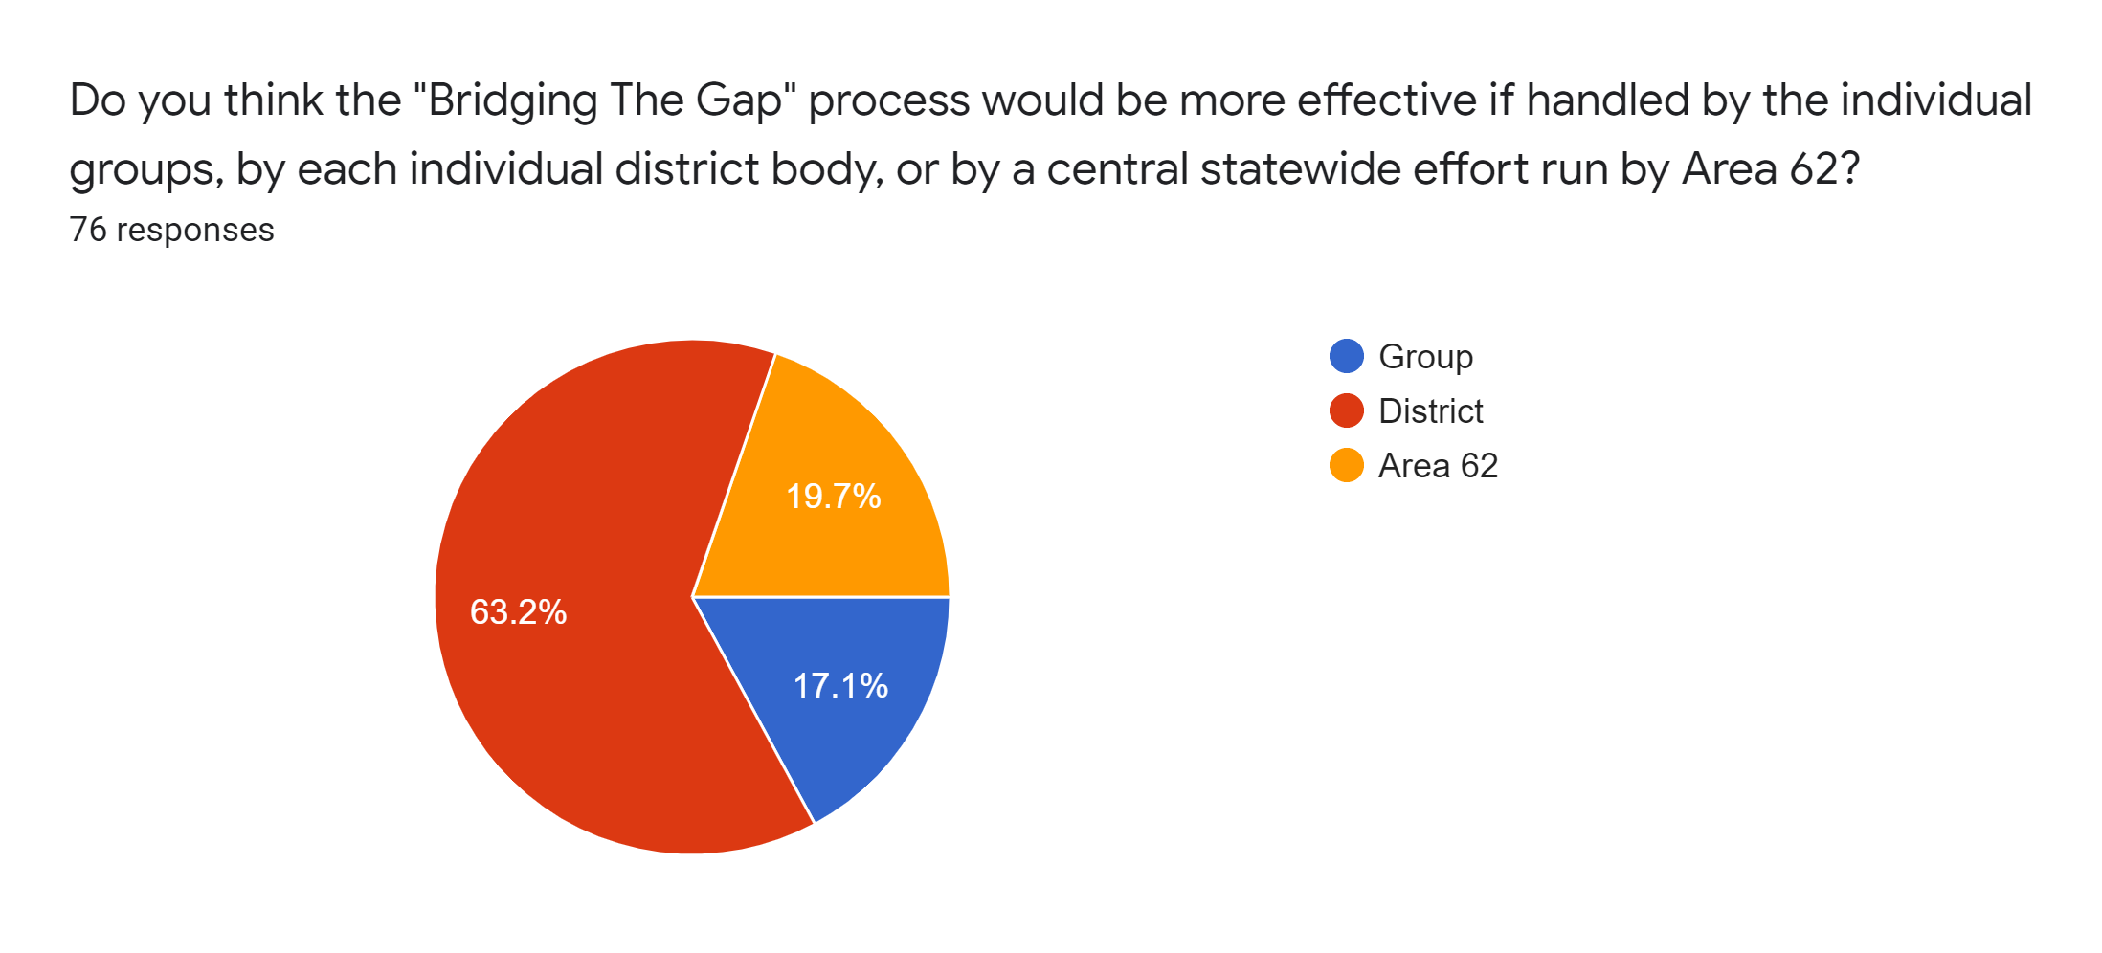
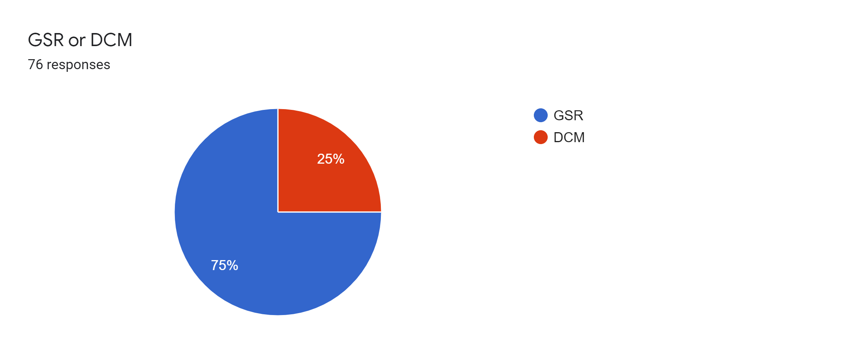
2. See if it is preferable to leave Bridging the Gap activities to respective Districts or Groups in Area 62 or whether it would be helpful to have a central (Area wide) location.

Slide 6
3. Determine the needs of the Districts (or the Groups) if the Bridging the Gap activities are to remain allocated to them.
Area Treatment and Corrections Chair could work directly with District committee chairs to assess BTG needs. Each District will probably have different needs based on the status of their BTG program.
More will be revealed!

Slide 7
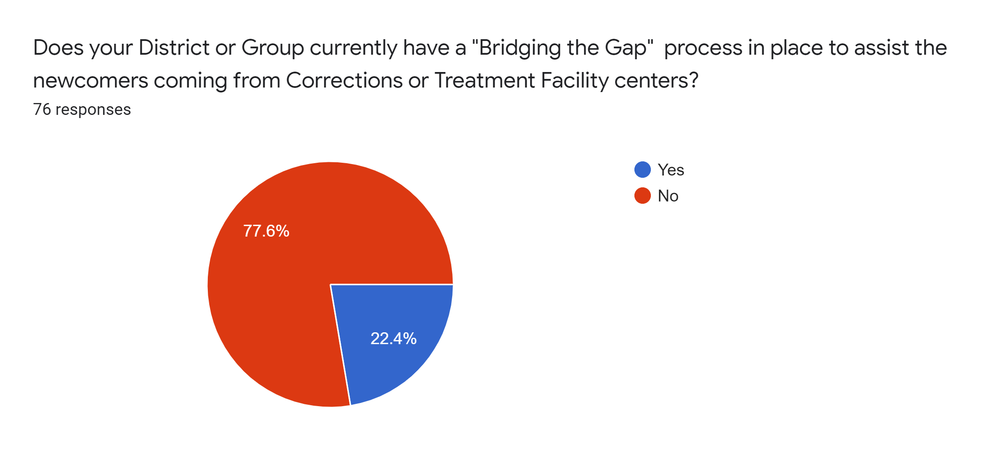
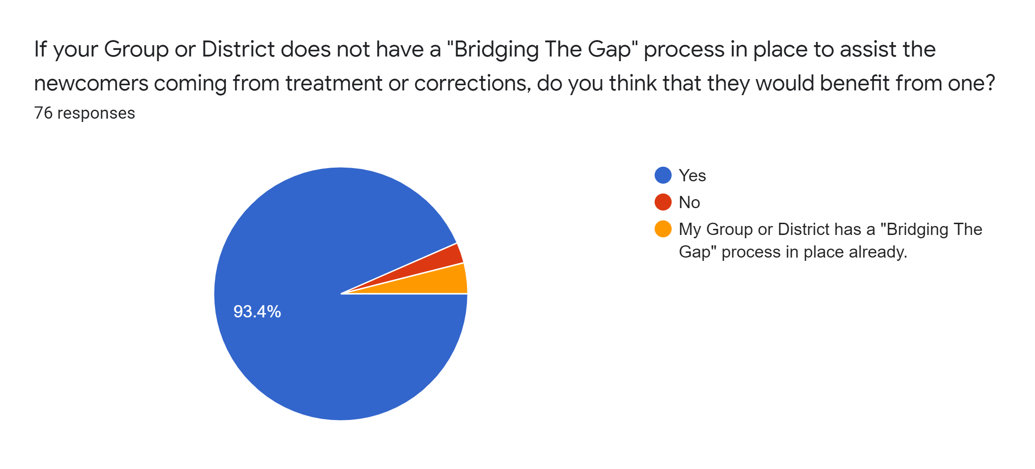
4. How can Area 62 best carry the message to people in treatment and corrections facilities?

Slide 8
5. How can our members, organizations and volunteers best cooperate with those facilities?
Area 62 to make treatment and corrections workbooks, handouts, and other resources available to area 62 members on area62 website
Area 62 could gather and share best practices from Districts and groups available
Refer to AA Treatment and Corrections workbook and pamphlets.
Treatment and Corrections could work with CPC as suggested in workbooks.

Slide 9
6. What are other Areas in Alcoholics Anonymous doing in these situations? What does GSO have available?
https://www.aa.org/pages/en_US/corrections-committees
https://www.aa.org/pages/en_US/treatment-committees
http://www.btgww.org/
http://www.utahaa.org/BTG/btg.html
https://nc23.org/2019/04/01/bridging-the-gap-alcoholics-anonymous-temporary-contacts/
http://eamo.org/bridging-the-gap/

Slide 10
Suggestion from BTG Adhoc Committee
It is a suggestion of the BTG Adhoc committee to the Area that a BTG ongoing meeting, Facilitated by the Area Treatment and Corrections chairs, be added to the Area Assembly agenda on Saturday at 4:00pm. It is our hopes that this meeting would increase collaboration amongst the districts and that best practices could be shared.
It is a suggestion of the BTG Adhoc committee to the Area to have a BTG workshop at the next Area Assembly.
It is the suggestion of the BTG Adhoc committee to the Area to dissolve as the finding are complete.

